Slide 1

Chapter 25
Creating a Viable Software Plan
Part Four – Managing Software Projects

Slide 2
Estimation Issues
Estimation of resources, cost, and schedule for a software engineering effort requires:
Experience.
Access to good historical information (metrics).
The courage to commit to quantitative predictions when qualitative information is all that exists.
Estimation carries inherent risk and this risk leads to uncertainty:
Project complexity.
Project size (makes decomposition tougher).
Degree of structural uncertainty (requirements stability).

Slide 3
Project Planning Task Set 1
Establish project scope.
Determine feasibility.
Analyze risks (Chapter 26).
Define required resources.
a. Determine required human resources.
b. Define reusable software resources.
c. Identify environmental resources.
Estimate cost and effort.
a. Decompose the problem.
b. Develop two or more estimates.
c. Reconcile the estimates.

Slide 4
Project Planning Task Set 2
Develop an initial project schedule.
a. Establish a meaningful task set.
b. Define a task network.
c. Use scheduling tools to develop a time-line chart.
d. Define schedule tracking mechanisms.
Repeat steps 1 to 6 to create a detailed schedule for each prototype as the scope of each prototype is defined.

Slide 5
What is Scope?
Software scope describes
Functions and features to be delivered to end-users.
Data input and output.
Content presented to users of using the software.
Performance, constraints, interfaces, and reliability that bound the system.
Scope is defined using one of two techniques:
A narrative description of software scope is developed after communication with all stakeholders.
A set of use-cases is developed by end-users.

Slide 6
Project Feasibility
Once scope has been identified (with the concurrence of the customer), it is reasonable to ask:
Can we build software to meet this scope?
Is the project feasible?
You must try to determine if the system can be created using available technology, dollars, time, and other resources.
Consideration of business need is important too - it does no good to build a high-tech system or product that no one wants.

Slide 7
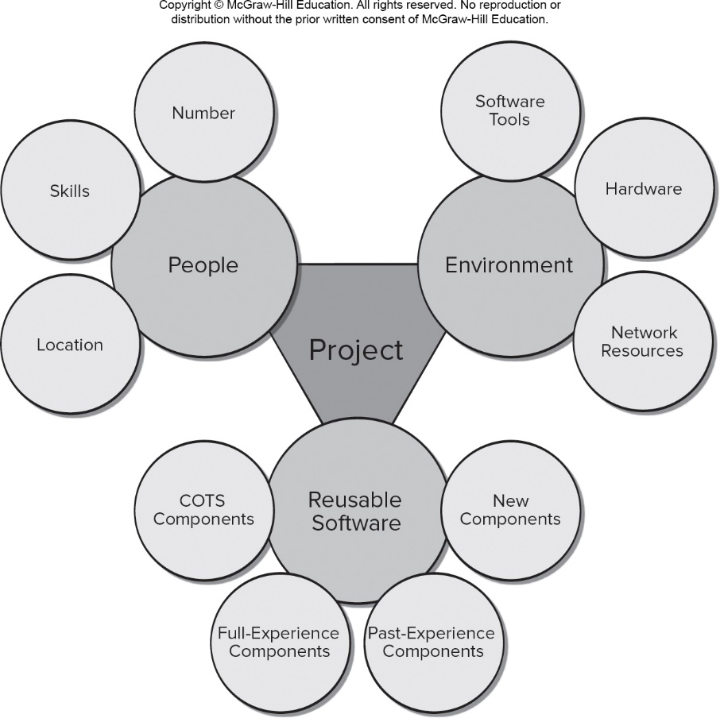
Project Resources
Access the text alternative for slide images.

Slide 8
Data Analytics and Estimation Accuracy
To achieve reliable cost and effort estimates several options arise:
Delay estimation until late in the project (we can achieve 100 percent accurate estimates after the project is complete!).
Base estimates on similar projects that have already been completed (works great if you have completed similar projects).
Use relatively simple decomposition techniques to generate project cost and effort estimates (similar to divide and conquer).
Use one or more empirical models for software cost and effort estimation (often derived using statistical regression models).

Slide 9
Reconciling Estimates
Any estimation technique must be checked by computing at least one other estimate using a different approach.
If you have created multiple estimates they need to be compared and reconciled.
If both estimates show agreement, there is good reason to believe that the estimates are reliable.
Widely divergent estimates can often be traced to one of two causes:
The scope of the project is not adequately understood or has been misinterpreted by the planner.
Productivity data used for problem-based estimation techniques is inappropriate for the application or has been misapplied.

Slide 10
Problem-Based Estimation 1
L O C and F P data are used in two ways during software project estimation:
as estimation variables to “size” each element of the software
as baseline metrics collected from past projects and used with other variable to develop cost and effort projections.
When collecting productivity metrics for projects, be sure to establish a taxonomy of project types.
Be sure that your estimates include the effort required to develop “infrastructure” software.

Slide 11
Problem-Based Estimation 2
Begin with a bounded statement of software scope.
Decompose the statement of scope into problem functions that can each be estimated individually.
L O C or F P is then estimated for each function.
Baseline productivity metrics (For example, L O C/pm or F P/pm) are then applied to the appropriate estimation variable.
Cost/effort for the function is derived using historic data.
Function estimates are combined to produce an overall estimate for the entire project.

Slide 12
L O C-Based Estimation Table
Copyright © McGraw-Hill Education. All rights reserved. No reproduction or distribution without the prior written consent of McGraw-Hill Education.
Function | Estimated L O C
User-interface and control facilities (U I C F) | 2,300
Two-Dimensional geometric analysis (2D G A) | 5,300
Three-Dimensional geometric analysis (3D G A) | 6,800
Database management (D B M) | 3,350
Computer graphics display facilities (G C D F) | 4,950
Peripheral control function (P C F) | 2,100
Design analysis modules (D A M) | 8,400
Estimated lines of code | 33,200

Slide 13
L O C-Based Estimation
Average productivity for these systems is 620 L O C/pm.
Burdened labor rate is $8000 per month.
Cost per line of code is approximately $13.
Based on L O C estimates and historical data:
estimated project cost is $431,000
estimated effort is 54 person-months

Slide 14
F P-Based Estimation Table
Copyright © McGraw-Hill Education. All rights reserved. No reproduction or distribution without the prior written consent of McGraw-Hill Education.
Table 25.1 Estimating information domain values
Information domain value | Opt. | Likely | Pess. | Est count. | Weight | F P count
Number of external inputs | 20 | 24 | 30 | 24 | 4 | 96 (24 × 4 = 96)
Number of external outputs | 12 | 14 | 22 | 14 | 5 | 70 (14 × 5 = 70)
Number of external enquiries | 16 | 20 | 28 | 20 | 5 | 100 (20 × 5 = 100)
Number of internal logical files | 4 | 4 | 5 | 4 | 10 | 40 (4 × 10 = 40)
Number of external interface files | 2 | 2 | 3 | 2 | 7 | 14 (2 × 7 = 14)
Count Total |  |  |  |  |  | 320

Slide 15
F P-Based Estimation
To compute the F P equation:
For the purposes of this estimate, the complexity weighting factor is assumed to be average and the F P count total from the table is 320.
Assume the sum of the 14 complexity factors
The estimated number of F P can be computed:
If the historic cost per F P is approximately $1,230 then total estimated project cost is $461,000 estimated effort is 58 person-months.

Slide 16
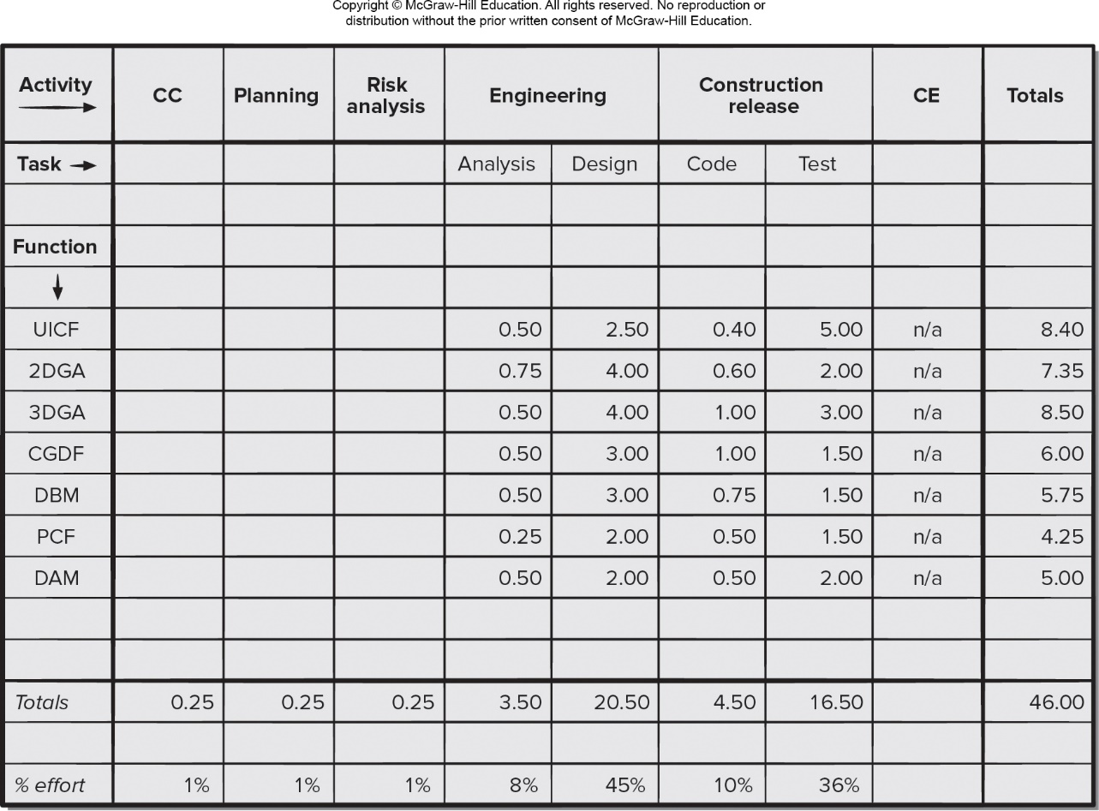
Process-Based Estimation Table
Access the text alternative for slide images.

Slide 17
Process-Based Estimation
Process-based estimation begins with a delineation of software functions obtained from the project scope.
A series of framework activities are performed for each function.
Functions and related framework activities may be represented as part of a table with tasks as columns and rows as functions.
The effort estimates (for example, person-months) are entered as the matrix cell values.
Average labor rates (that is, cost/unit effort) are then applied to the effort estimated for each process activity.
Based on an average burdened labor rate of $8,000 per month, the total estimated project cost is $368,000 and the estimated effort is 46 person-months based on the matric entries.

Slide 18
Use Case Point Estimation
Computation of use case points takes the following into account:
The number and complexity of the use cases in the system.
The number and complexity of the actors on the system.
Various nonfunctional requirements not written as use cases.
The environment in which the project will be developed.
U C P = (U U C W + U A W) × T C F × E C F
U U C W – unadjusted sum of use case weights
U A W – unadjusted sum of actor weight
T C F – technical complexity 13 factors
E C F – environment complexity 8 factors

Slide 19
Use Case Point Estimation Example 1
The engineering subsystem group is described by 14 average use cases and 8 simple use cases. And the infrastructure subsystem is described with 10 simple use cases.
U U C W = (16 use cases × 15) + [(14 use cases × 10)
+ (8 use cases × 5)] + (10 use cases × 5) = 470
There are 8 simple actors, 12 average actors, and 4 complex actors.
U A W = (8 actors × 1) + (12 actors × 2) + (4 actors × 3) = 44
After evaluation of the technology and the environment,
T C F = 1.04
E C F = 0.96
U C P = (470 + 44) × 1.04 × 0.96 = 513

Slide 20
Use Case Point Estimation Example 2
Using past project data as a guide, the development group produces 85 L O C per U C P.
An estimate of the overall size of the C A D project is 43,600 L O C.
Using 620 L O C/pm as the average productivity for systems of this type and a burdened labor rate of $8,000 per month, and the cost per line of code is approximately $13.
Based on the use case estimate and the historical productivity data:
Total estimated project cost is $552,000.
Estimated effort is about 70 person-months.

Slide 21
Agile Project Estimation
1. Each user story is considered separately for estimation purposes.
2. Each user story is decomposed into the set of software engineering tasks that will be required to develop it.
3a. Each task is estimated separately (historic data, empirical model,
experience, or planning poker.
3b. Alternatively, the “volume” of the user story can be estimated in
LOC, FP, or use case count.
4a. Estimates for each task are summed to estimate the user story.
4b. Alternatively, the volume translated into effort using historical data.
5. Effort estimates for all user stories are summed to create effort estimate for the increment.

Slide 22
Why Are Projects Late?
Unrealistic deadline established by someone outside the software team and forced on managers and practitioners on the group.
Changing requirements not reflected in schedule changes.
An honest underestimate of the amount of effort and/or the number of resources that will be required to do the job.
Predictable and/or unpredictable risks that were not considered when the project commenced.
Technical difficulties that could not have been foreseen in advance.
Human difficulties that could not have been foreseen in advance.
Miscommunication among project staff that results in delays.
Failure by project management to recognize that the project is falling behind schedule and lack of action to correct the problem.

Slide 23
Scheduling Principles
Compartmentalization. The project must be compartmentalized by decomposing the product and the process.
Interdependency. The interdependency of each compartmentalized activity or task must be determined.
Time allocation. Each task must be allocated some number of work units and assigned a start date and a completion date.
Effort validation. Ensure that no more than the allocated number of people has been scheduled at any given time.
Defined responsibilities. Every task that is scheduled should be assigned to a specific team member.
Defined outcomes. Every task should have a defined outcome.
Defined milestones. Every task should be associated with a project milestone.

Slide 24
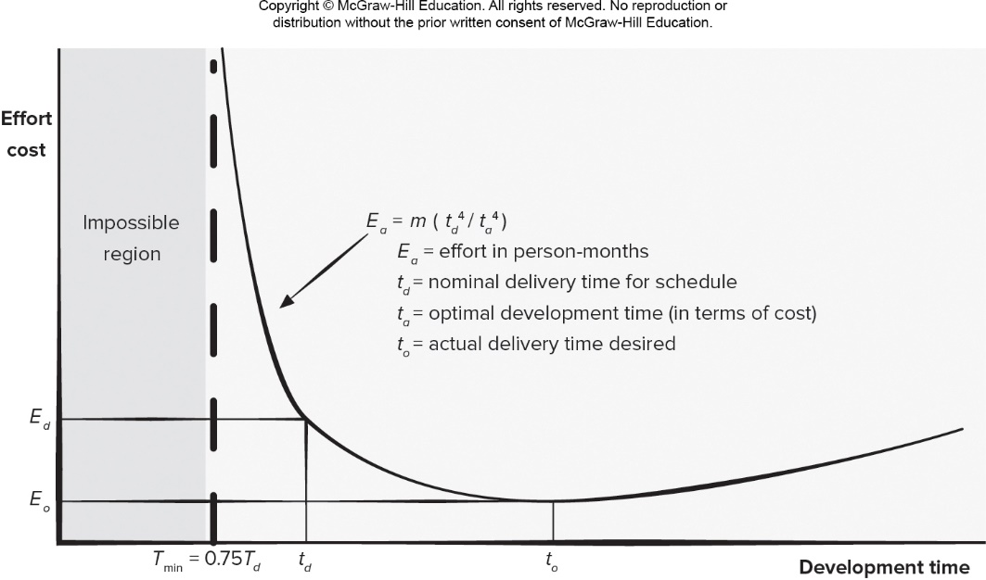
Relationship Between Effort and Delivery Date
Access the text alternative for slide images.

Slide 25
Concept Development Task Set
1.1 Concept scoping determines the overall scope of the project.
1.2 Preliminary concept planning establishes the organization’s ability to undertake the work implied by the project scope.
1.3 Technology risk assessment evaluates the risk associated with the technology to be implemented as part of the project scope.
1.4 Proof of concept demonstrates the viability of a new technology in the software context.
1.5 Concept implementation implements the concept representation in a manner that can be reviewed by a customer and is used for “marketing” purposes when a concept must be sold to other customers or management.
1.6 Customer reaction to the concept solicits feedback on a new technology concept and targets specific customer applications.

Slide 26
Task 1.1 Refinement
Task definition: Task 1.1 Concept Scoping
1.1.1 Identify need, benefits and potential customers;
1.1.2 Define desired output/control and input events that drive the application;
Begin Task 1.1.2
1.1.2.1 FTR: Review written description of need indicates that a FTR is to be conducted.
1.1.2.2 Derive a list of customer visible outputs/inputs
1.1.2.3 FTR: Review outputs/inputs with customer and revise as required;
endtask Task 1.1.2
1.1.3 Define the functionality/behavior for each major function;
Begin Task 1.1.3
1.1.3.1 FTR: Review output and input data objects derived in task 1.1.2;
1.1.3.2 Derive a model of functions/behaviors;
1.1.3.3 FTR: Review functions/behaviors with customer and revise as required;
endtask Task 1.1.3
1.1.4 Isolate those elements of the technology to be implemented in software;
1.1.5 Research availability of existing software;
1.1.6 Define technical feasibility;
1.1.7 Make quick estimate of size;
1.1.8 Create a Scope Definition;
endTask definition: Task 1.1

Slide 27
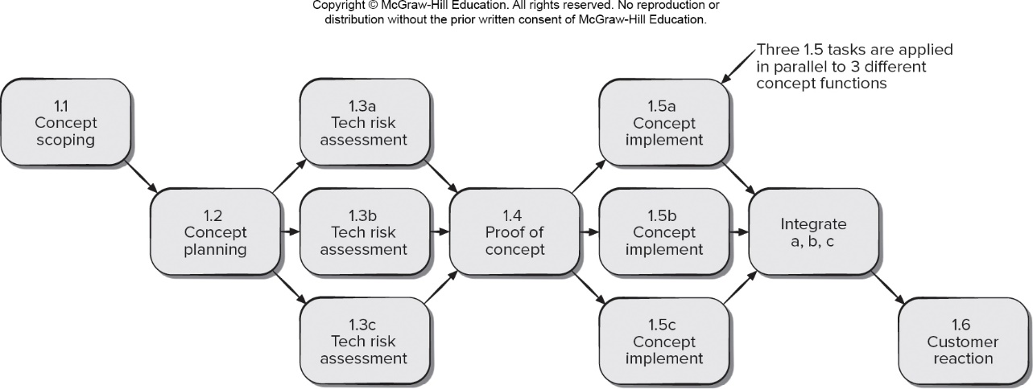
Task Network (Activity Network)
Access the text alternative for slide images.

Slide 28
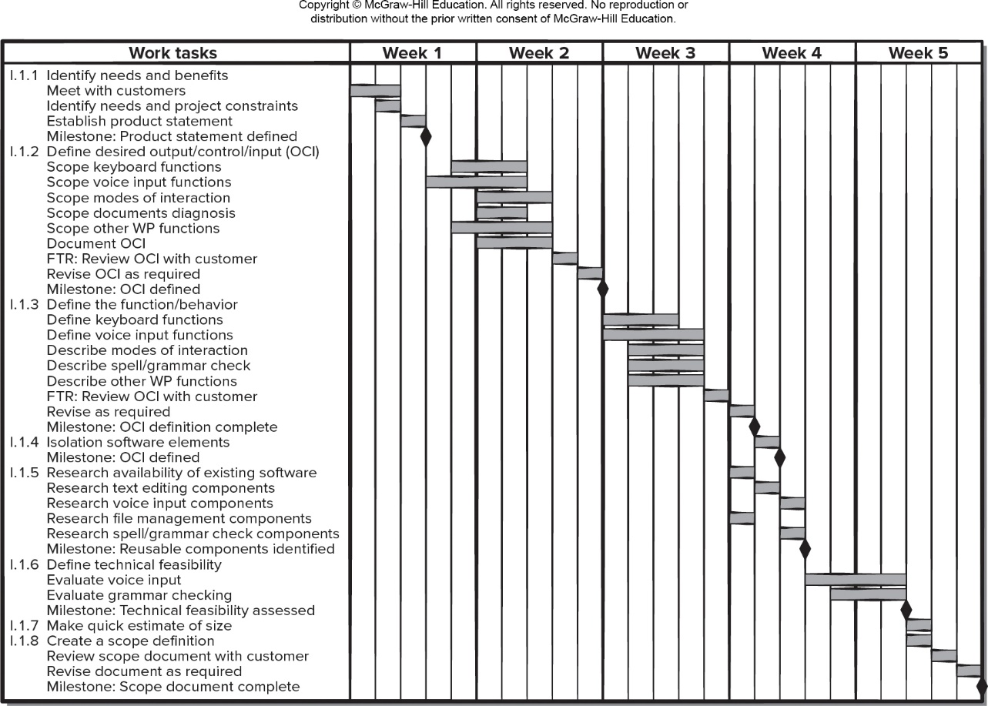
Timeline Chart (Gantt Chart)

Slide 29
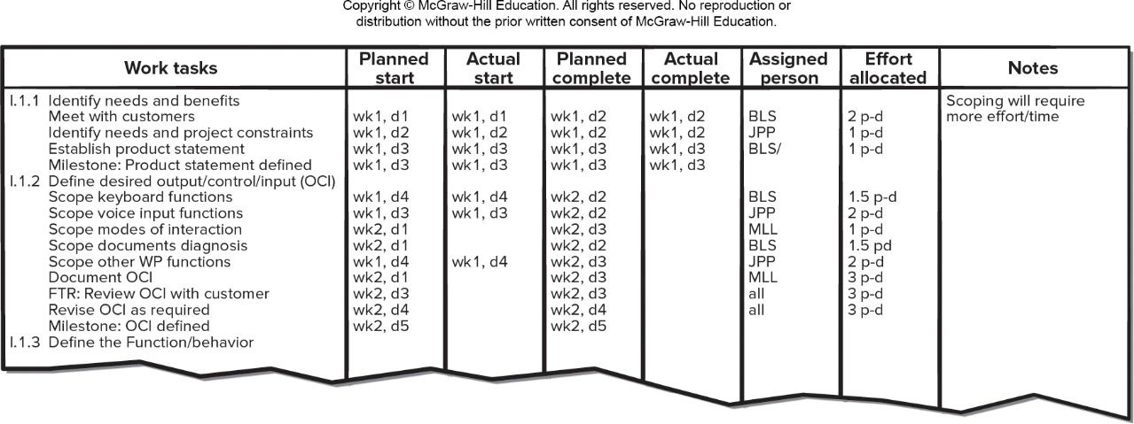
Project Table for Project Tracking
Access the text alternative for slide images.

Slide 30
Schedule Tracking
Conducting periodic project status meetings in which each team member reports progress and problems.
Evaluating the results of all reviews conducted throughout the software engineering process.
Determining whether formal project milestones have been accomplished by the scheduled date.
Comparing the actual start date to the planned start date for each project task listed in the project resource table.
Meeting informally with practitioners to obtain their subjective assessment of progress to date and problems on the horizon.
Tracking the project velocity, which is a way of seeing how quickly the development team is clearing the user story backlog.

Slide 31
End of Main Content

Slide 32
Accessibility Content: Text Alternatives for Images

Slide 33
Project Resources – Text alternative
Return to parent-slide containing images
The diagram shows project resources. A central triangle labeled project connects to people, environment and reusable software. Reusable software entails: COTS components, full-experience components, past-experience components and new components. People entails: number, skills and location. Environment entails: software tools, hardware and network resources.
Return to parent-slide containing images

Slide 34
Process-Based Estimation Table – Text alternative
Return to parent-slide containing images
A process based estimation table has activity and task in the column headings and the functions as different rows. The activities are: C C, planning, risk analysis, engineering, construction release, C E and totals. The tasks under engineering are: analysis and design and under construction release are: code and test.
Return to parent-slide containing images

Slide 35
Relationship Between Effort and Delivery Date – Text alternative
Return to parent-slide containing images
A graph plots the relationship between effort and delivery time. The graph is plotted for effort cost versus development time. The graph shows a curve that fall along the y axis towards the x axis and rises again as time increases. The curve has the following function: E sub a = m time (t sub d to the power 4 over t sub a to the power 4). The variables are defined as follows: E sub a = effort in person months; t sub d = nominal delivery time for schedule; t sub a = optimal development cost in terms of cost; t sub o = actual delivery time desired. On the left of the curve a dotted line between the curve and y axis a shaded region defines the impossible region. The line is plotted at T sub min = 0.75 T sub d.
Return to parent-slide containing images

Slide 36
Task Network (Activity Network) – Text alternative
Return to parent-slide containing images
The task network is follows: 1.1 concept scoping; 1.2 concept planning. 1.3a, tech risk assessment; 1.3b, tech risk assessment; 1.3c, tech risk assessment. 1.4, proof of connect; 1.5a, concept implement; 1.5b, concept implement; 1.5c, concept implement; Three 1.5 tasks are applied in parallel to 3 different concept functions. After 1.5 integrate a b c; 1.6 customer reaction.
Return to parent-slide containing images

Slide 37
Project Table for Project Tracking – Text alternative
Return to parent-slide containing images
A project table for project tracking lists the work tasks. The other column headings are: planned start, actual start, planned complete, actual complete, assigned person, effort allocated and notes.
Return to parent-slide containing images

